Slide 1

DARK BLUE BIKES Bike Sharing Management System
By: Ashish Mhatre, Ashwin Kadam, Harshad Jadhav, Dalsi Patel, Samruddhi Narawade

Slide 2
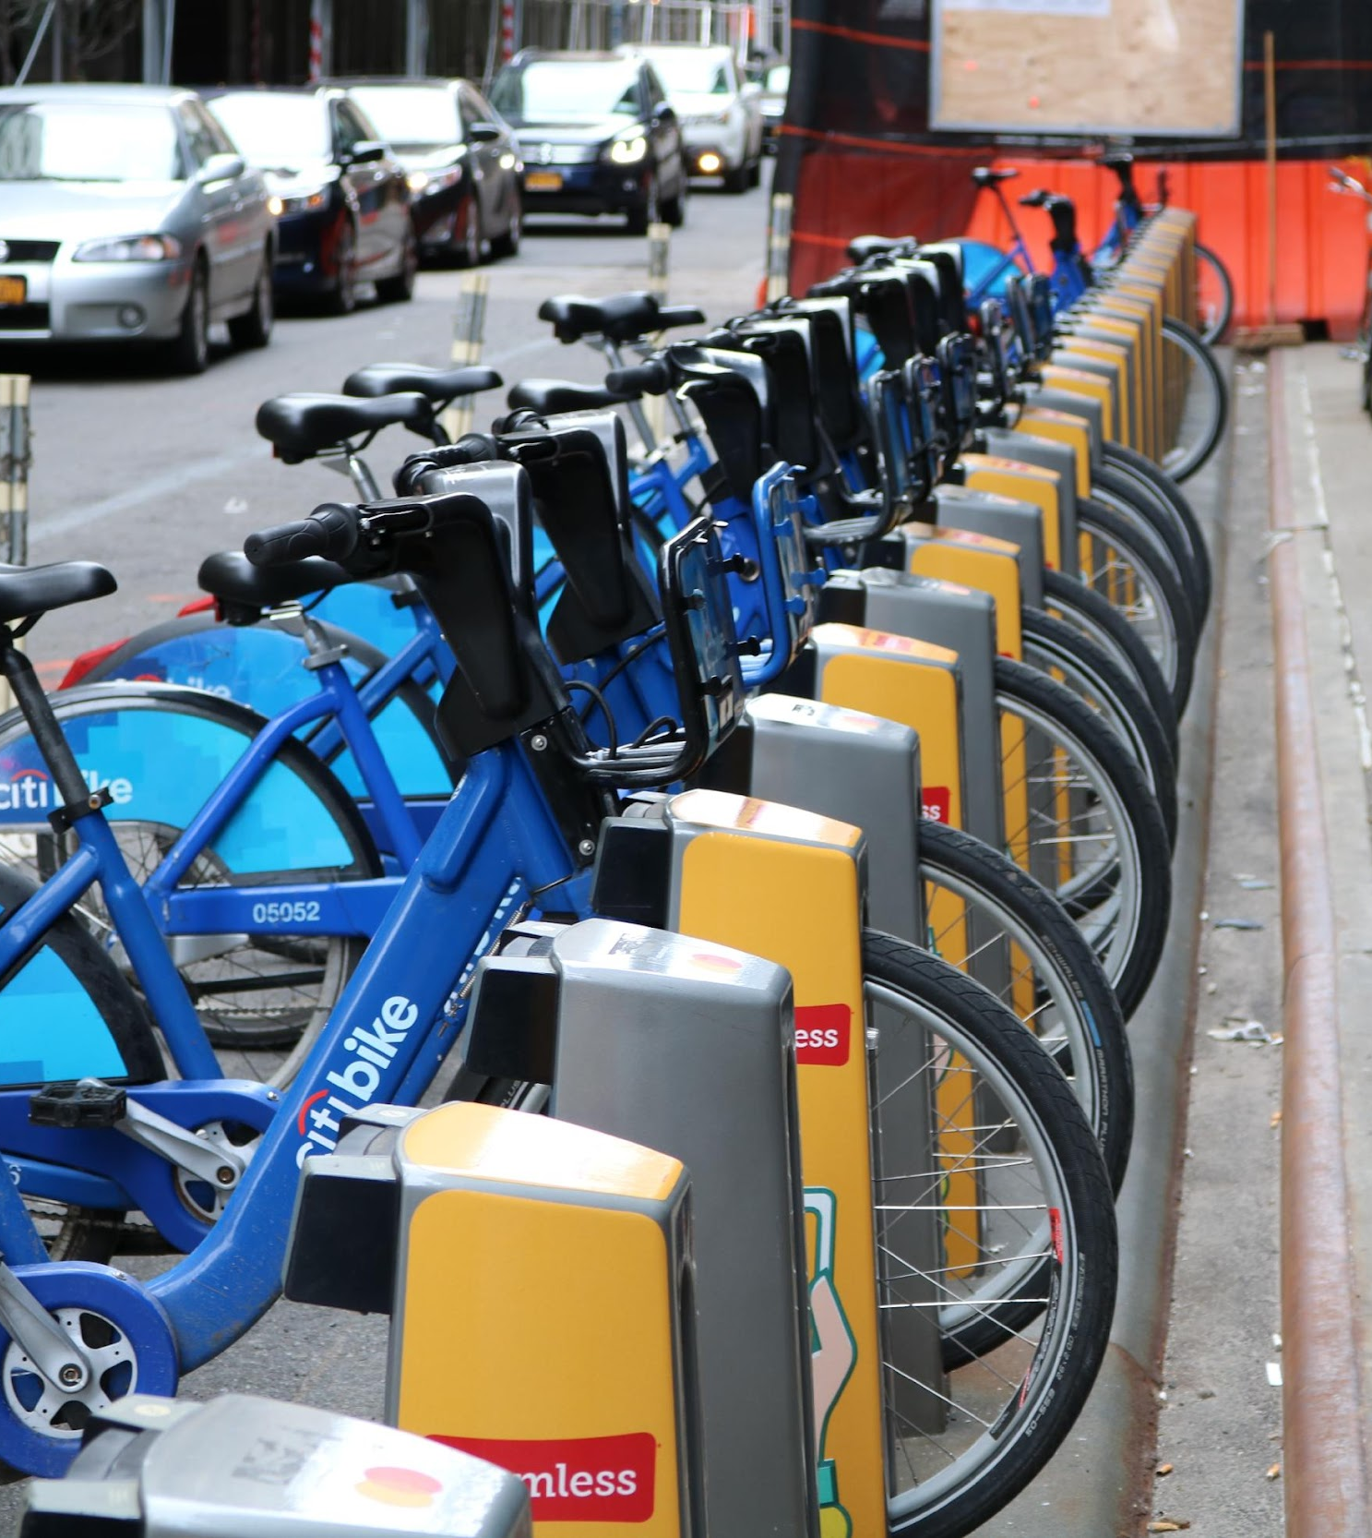
Agendas
Problem Statement
Proposed Solution
Key Features
Implemented concepts
Reports-Graphs
Team Contribution
Github Contribution

Slide 3
Problem Statement
Facilitate Customer onboarding by creating a rider account, maintain ride details and transactional payment details
Identifying frequent user details and offer additional discounts to increase customer retention
To track the health of the bikes and notify the maintenance team as and when required
Implementing data security on various database objects. Analytical reports are generated for business development team to manage and expand the business by identifying trends and patterns.

Slide 4
Proposed Solution
Handle Customer onboarding and offboarding
Track Health of bikes and schedule/Notify maintenance team
Improve services based on customer’s feedback report
Deliver business insights to build stations at high demand zip codes
Revenue generated per quarter/month based on zip code/location
Maintain Customer and Customer Address table to store customer information and use this information to deliver personalized offers as per ride records. Business development team can use this information to understand the customer base.
Maintain Ride Transaction table and Bike table to store details on each ride. Utilize this information to calculate total distance travelled by a particular bike and schedule maintenance when a decided threshold distance is reached. Notify maintenance team for maintenance
Maintain Customer_Feedback table to store customer feedback data and based on this data we will generate the customer ride experience report for the business team.
From the Ride_Transaction table and Station table, generate a view to show the number of bookings with respect to zip codes. This will help the business team to identify the busiest station among the riders.
From the Payment, Ride_transaction and Station table generate a report to sum up the revenue based on the zip code or location based on which we will get information about the performing and non-performing regions

Slide 5




Key Features
Ride Frequency will be analyzed for the business team to check the daily, weekly, monthly, quarterly, and yearly ride trend
Analysis of location performance to show the business team which zip code/location is performing good or bad eventually helping them to take adequate decisions.
To overview customer loyalty by analyzing the frequency of the service being used by a particular customer and giving loyal customers discounts, encouraging more engagement.
Keeping track of the wear and tear of the bikes to schedule timely maintenance assuring the long life of the bike and reducing unnecessary breakdowns while in use.
Implementing data security for customer and payment details.

Slide 6
Implemented Concepts
Database object creation
Data security and privilege
Stored procedures
Functions
Exception Handling
Packages
Views
Reports

Slide 7
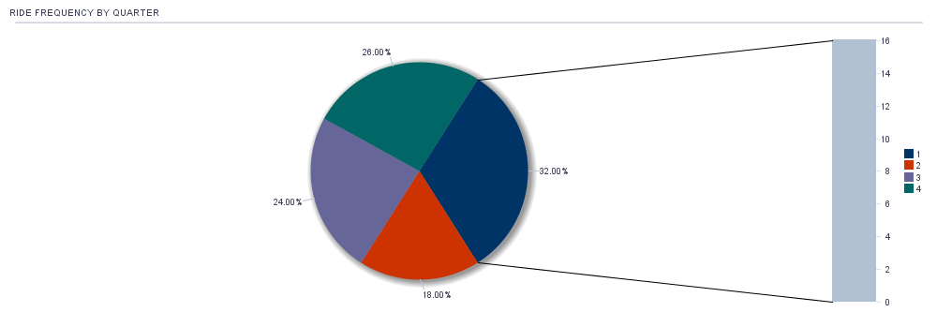
Reports - Graphs

Slide 8
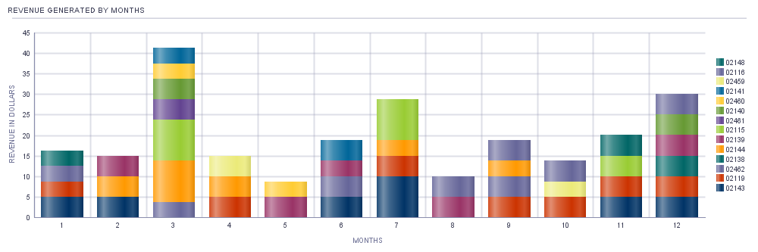
Reports - Graphs

Slide 9
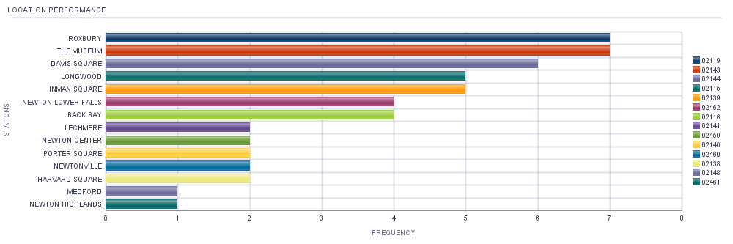
Reports - Graphs

Slide 10
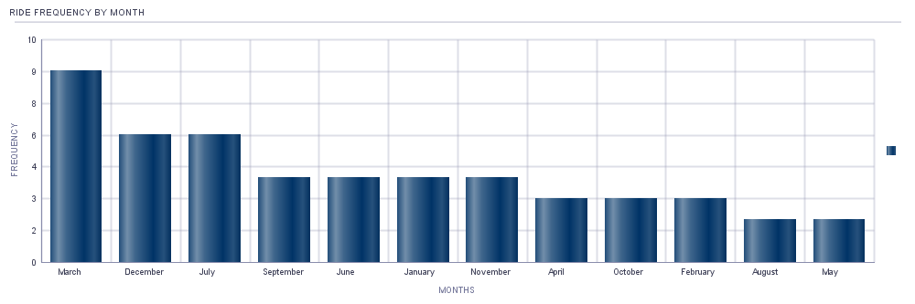
Reports - Graphs

Slide 11
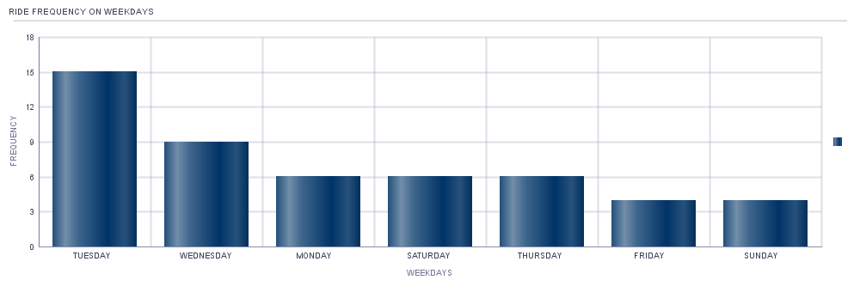
Reports - Graphs

Slide 12
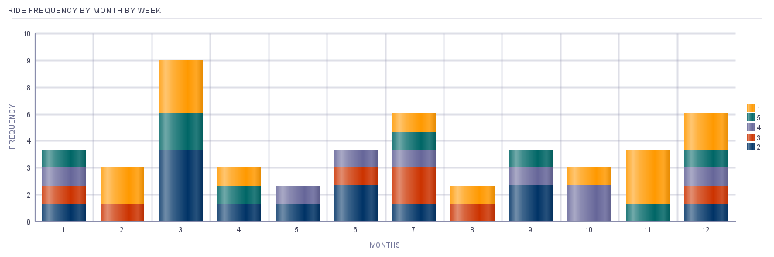
Reports - Graphs

Slide 13
Team Contribution
Table creation : All team members
Users Creation & Stored Procedures : Ashish, Harshad, Ashwin
Functions and Views : Dalsi, Samruddhi
Data insertion & PPT : Dalsi, Samruddhi
Reports : Ashish, Harshad, Ashwin

Slide 14
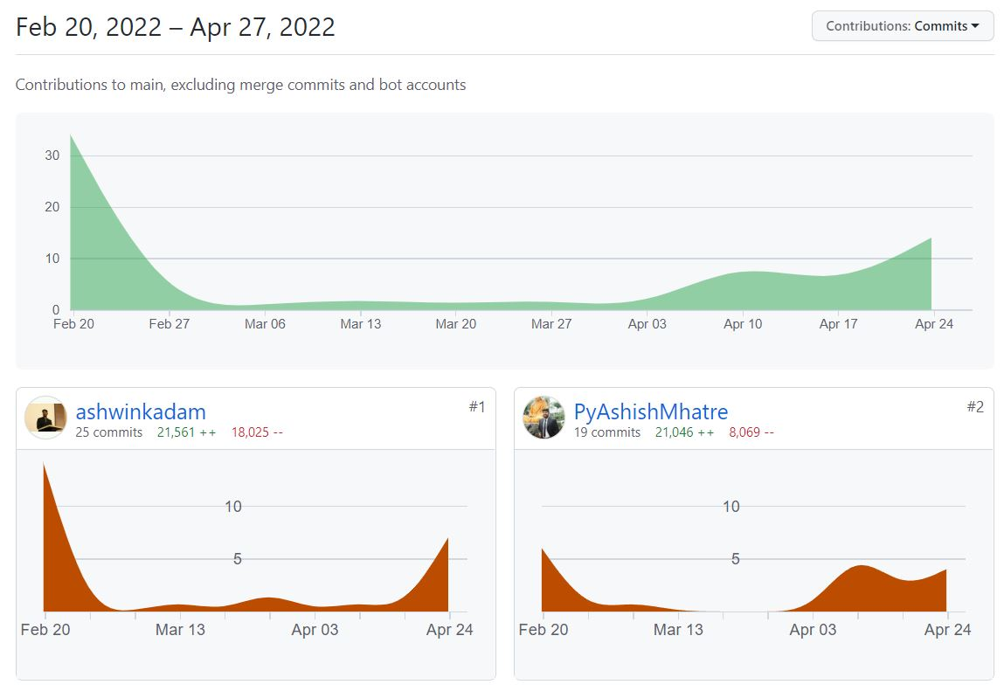
GitHub Contributions

Slide 15
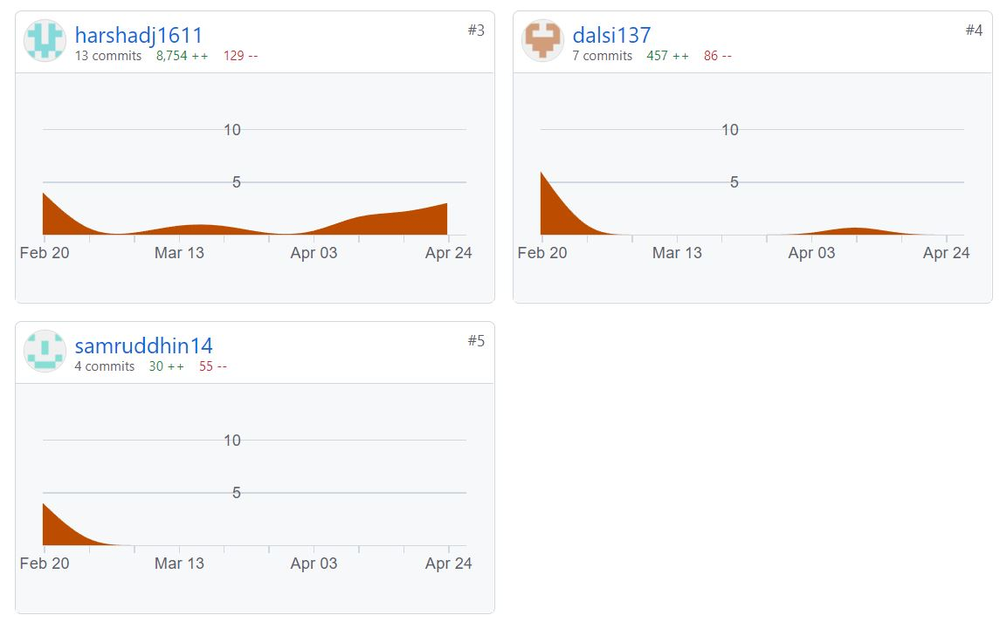
GitHub Contributions

Slide 16
THANK YOU

